Slide 1



BLOCKCHAIN-BASED SMART CONTRACT
IN E-LIBRARY
MABEL LE
THIEN MAI DO
TIEN THANH DO

Slide 2

CURRENT DATA GOVERNANCE
Digital Transformation of Libraries
Libraries are shifting from traditional to digital operational models.
Advanced technologies like AI and ML are being explored and implemented.
Most libraries still rely on centralized data management systems for consistency, maintenance, and security
Popular management software (e.g., Koha, LibraryWorld) assists operations but faces limitations, especially in transaction and payment processing

Slide 3
CURRENT DATA GOVERNANCE
Traceability in Data Governance
Data Privacy Concerns
Transparency and Royalty Payment Issues
Enables tracking of data sources, collection methods, and modifications
Ensures all changes are accurately documented and verifiable.
Real-time insights allow administrators to detect inconsistencies or unauthorized alterations promptly.
Protecting data privacy is essential for secure, authorized access.
Vulnerable to automated bot attacks that may manipulate accounts or cause data breaches
Bots can expose sensitive information, cause credential stuffing, or trigger DoS attacks
Most e-book libraries and platforms use centralized management controlled by publishers or intermediaries
Authors cannot directly verify readings, downloads, or revenue calculations.
Lack of independent auditing allows data alteration or deletion, weakening trust, accountability, and data integrity.

Slide 4

CHALLENGES IN THE CURRENT SYSTEM
Centralized Payment Systems in Libraries
Limitations in Traceability and Auditing
Traditional royalty payments rely on Traditional auditing depends on centralized databases and manual reconciliation
Centralized logs are vulnerable to tampering, compromising audit integrity.
Lack of real-time visibility prevents continuous monitoring and immediate anomaly detection.
Compliance with evolving regulations (PCI DSS, GDPR, ISO 27001) remains challenging.
Traditional royalty payments rely on intermediaries (e.g., banks), causing delays and limited author participation.
Internal accounting systems struggle to verify revenue per book; authors cannot independently confirm downloads or payments.
Decentralized payment systems are proposed to enhance transparency and stakeholder autonomy
Security Risks in Centralized Systems
Single points of failure increase vulnerability to cyberattacks, such as bot penetration.
Sensitive data, including internal operations and user information, can be exposed or lost

Slide 5

PROPOSED BLOCKCHAIN-BASED SOLUTION
1.Overview of the Proposed Solution
Introduces a permissioned blockchain system for the entire e-library framework.
Validating nodes: authors, publishers, and libraries verify all transactions
Ensures data integrity, traceability, privacy, and accountability.
Smart contracts automate revenue distribution and transaction verification.
Uses IPFS for decentralized data storage to prevent system failures
Maintains permanent records of book registration and purchases for ownership verification and transparent financial tracking.

Slide 6

BLOCKCHAIN SOLUTION
2. Proposed Model / Architecture
Three-layer system:
User Interaction Layer
Blockchain Governance Layer
Data Storage Layer
3. Smart Contract-Based Payment Automation
Solidity smart contracts replace traditional banking systems.
Trigger automatically when readers purchase digital documents.
Handles payment verification and automatic revenue distribution:
80% → Author
15% → Publisher
5% → Library
Maintains immutable transaction records visible through blockchain explorers.
Eliminates middlemen, reduces disputes, and provides real-time revenue tracking

Slide 7


BLOCKCHAIN SOLUTION
4. Data Traceability and Audit Mechanism
Every action (registration, purchase, royalty payment) linked to a unique transaction hash.
Enables a transparent chain of custody: who did what, when, and how much was paid.
Supports real-time verification and auditing in compliance with ISO 27001 and GDPR
5. Consensus and Security Mechanisms
Uses Practical Byzantine Fault Tolerance (PBFT) for fast, energy-efficient validation
Public/private key encryption secures authentication and access control.
Tamper-proof storage: hashed data permanently recorded on-chain.
No single point of failure — decentralized nodes ensure continuity during outages or cyberattacks.
Improves system resilience, reliability, and security

Slide 8


BLOCKCHAIN SOLUTION
6. Governance and Compliance
Assigns Digital Identity (DID) to all participants with Role-Based Access Control (RBAC)
Author: manages copyright and ownership records.
Publisher: validates content and manages rights.
Library: oversees transactions and audits.
Smart contracts enforce automated governance and reduce human interference.
Complies with GDPR, ISO/IEC 27001, and Privacy Act 1988.
Ensures transparency, accountability, and confidentiality through permanent on-chain records

Slide 9

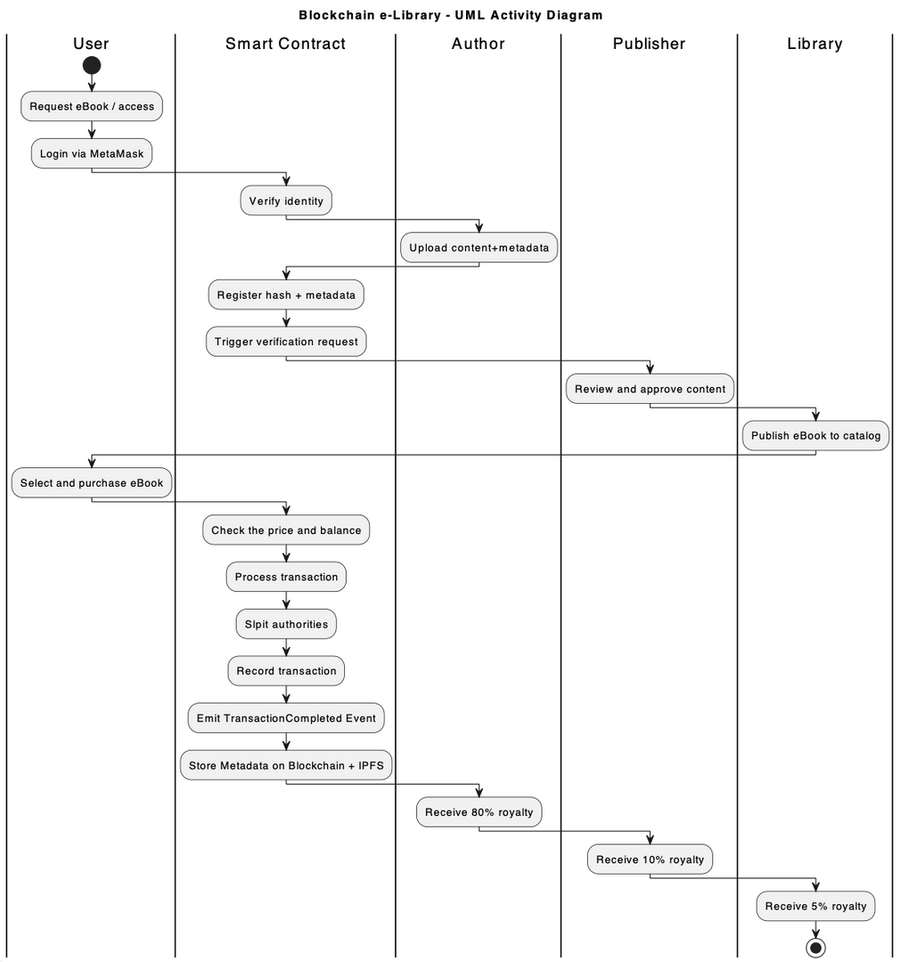
BUSA3007
BLOCKCHAIN E-LIBRARY WORKFLOW

Slide 10
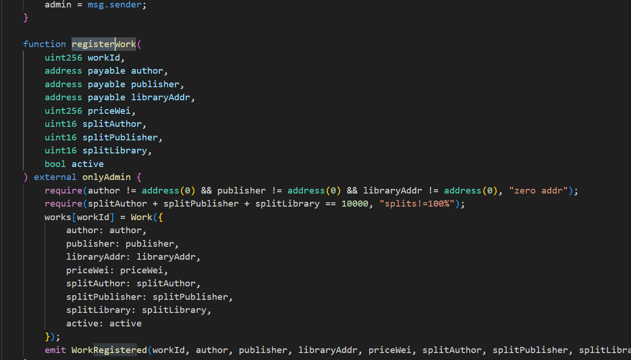

SMART CONTRACT PROTOTYPE
Programming Language: Solidity on the Ethereum blockchain.
Development Framework:
Hardhat: framework for compiling, testing, deploying smart contracts.
Hardhat Ignition manages deployment, upgrades, and script tracking.
Blockchain Interaction: Ethers.js library enables communication between the web interface and the Ethereum blockchain.
Key Smart Contract Functions:
registerWork() – Registers a new digital book on the blockchain.
purchase() – Allows buying registered e-books via one-time payment.
canAccess() – Verifies whether a user already owns or has purchased a specific e-book.
User Interaction Flow:
Users interact through a web interface to send transaction requests to the smart contract.
The transaction records are permanently stored on the blockchain, ensuring transparency, immutability, and trust in the system.

Slide 11
THANK YOU

